Slide 1
Catastrophic costs faced by TB patients and their families
Dr Thato Mosidi
Patient advocate and XDR TB survivor, TB Proof

Slide 2
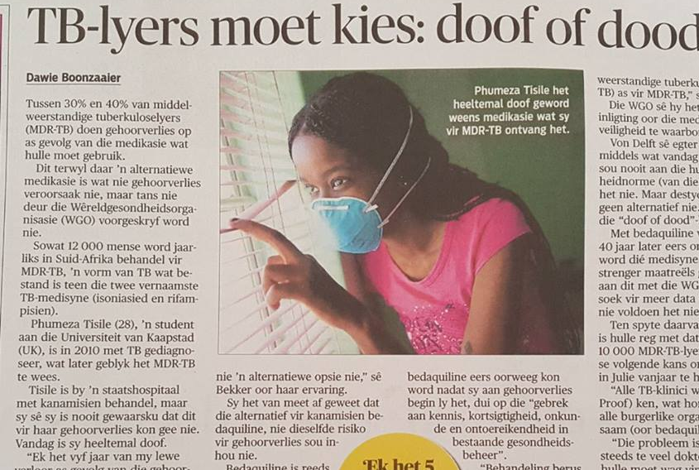
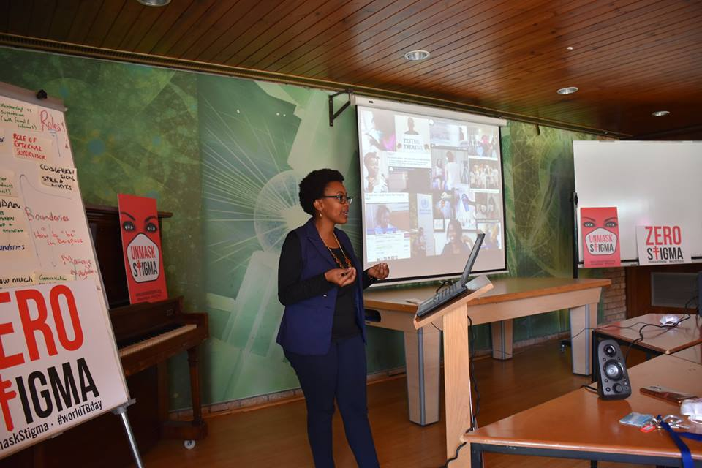
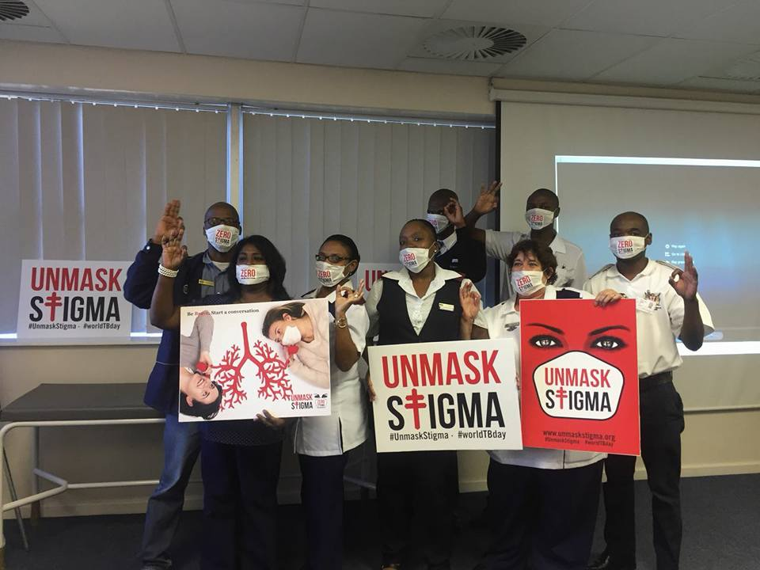
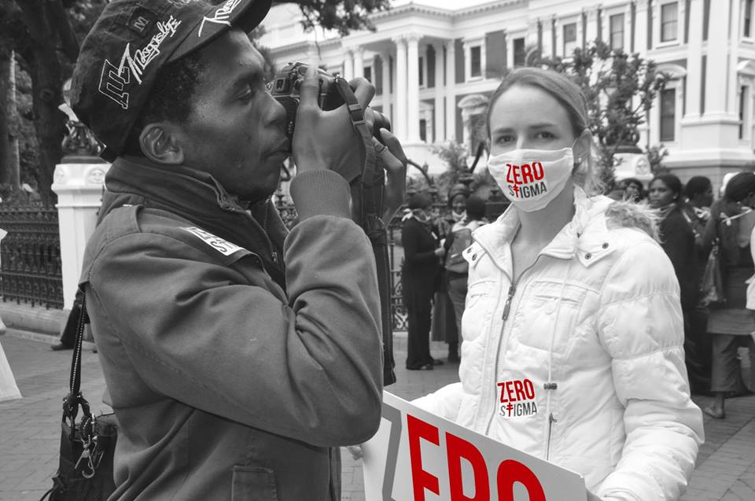

Slide 3
Accessed from: http://www.who.int/tb/End_TB_brochure.pdf?ua=1

Slide 4
The cycle
Higher risk
Reduced GDP
The poorer the community the greater the risk of being infected with TB
TB can weaken a countries GDP, through the loss or incapacitation of its working force
TB
POVERTY
Work and living conditions
Poorer communities/families tend to live in unideal environments, and places with a lack or poor basic health services
Loss of earnings
TB can push a families further into poverty due to lost months of work

Slide 5
What are catastrophic costs?
Travel costs
Traditional leaders
Private provider fees
Multiple visitations to the health facility
Other medication
Hospitalisation
Food costs
Caregiver
Child care
Loss of income
Time

Slide 6
What can be done?
Universal Health Coverage
Social support/protection

Slide 7
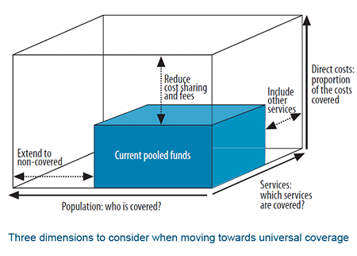
Universal Health Coverage
“…everyone, everywhere can access essential quality health services without facing financial hardship.”
*World health report
2010

Slide 8
TESTIMONIAL FROM A FORMER TB PATIENT

Slide 9
Social protection
Support to individual social service need
Cash transfers via NTP or GF
06
01
05
Social Welfare monthly grants
Food provided by nutrition programmes
02
04
03
Transport assistance or transport vouchers by NPOs.
TB patient income genaration projects

Slide 10
Catastrophic costs potentially averted by tuberculosis control in India and South Africa: a modelling study .Verguet S., et al. (2017) The Lancet Global Health, .
Accessed from: https://doi.org/10.1016/S2214-109X(17)30341-8

Slide 11
Next Steps?
The alleviation of catastrophic costs on people with TB and families requires everyone’s commitment.
All stakeholders have a role to play!
(CSOs, the public, governments, researchers and academics and implementers, private sector)
Multi-sectoral approach very important

Slide 12
Thank you for listening!
Dr Thato Mosidi
thatomosidi@gmail.com
TB Proof

